Slide 1
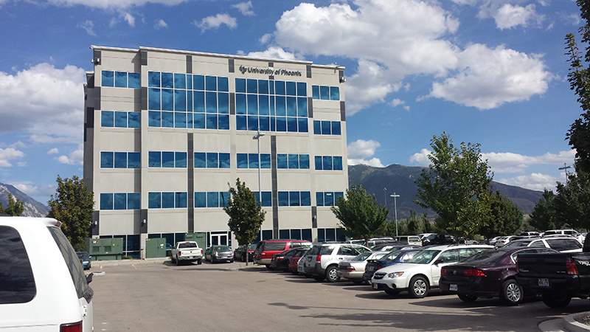
Data Architecture project- part II
Elbio iseas dbm/384
Faculty : Devin Dickens
08/29/2016

Slide 2
Introduction
The temporal database Payroll is one of the applications in the OLTP for the company. It uses four tables: one fact table (FactWorkedHours), and three dimension tables (DimDepartments), (DimEmployees), and (DimSalaries).
These tables build the dimensional model on a star schema, being the center the Fact table (FactWorkedHours).

Slide 3
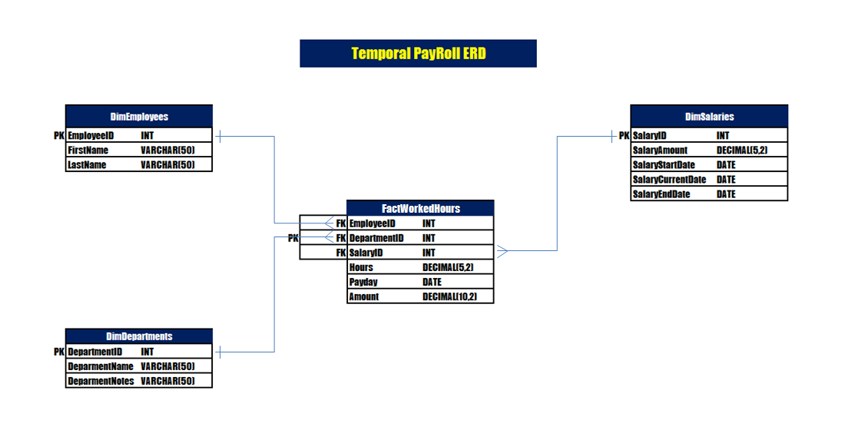
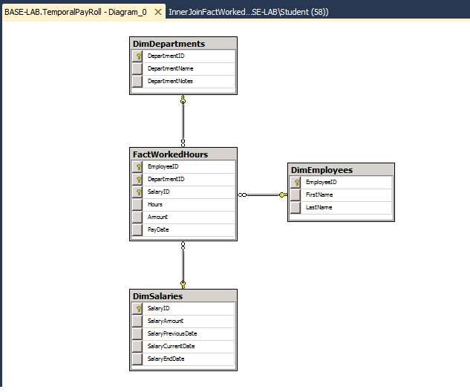
Temporal database erd
Temporal PayRoll
Diagram

Slide 4
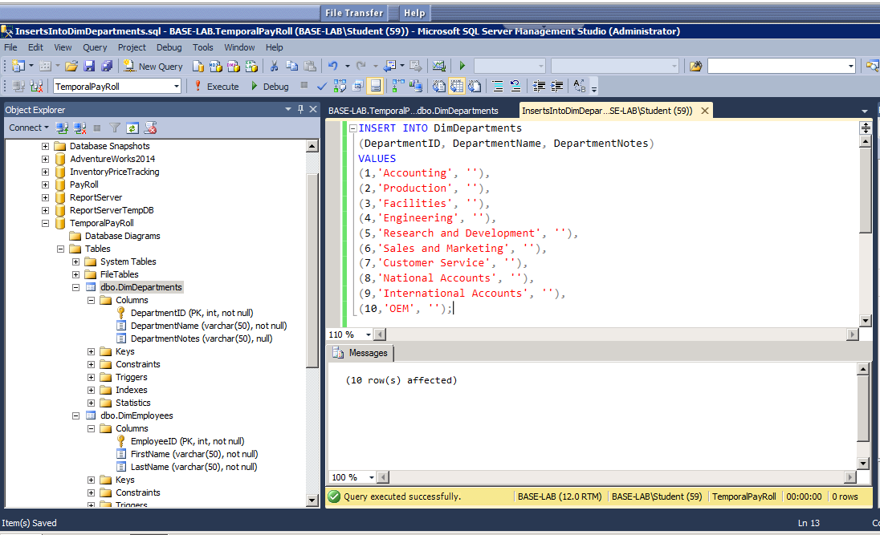
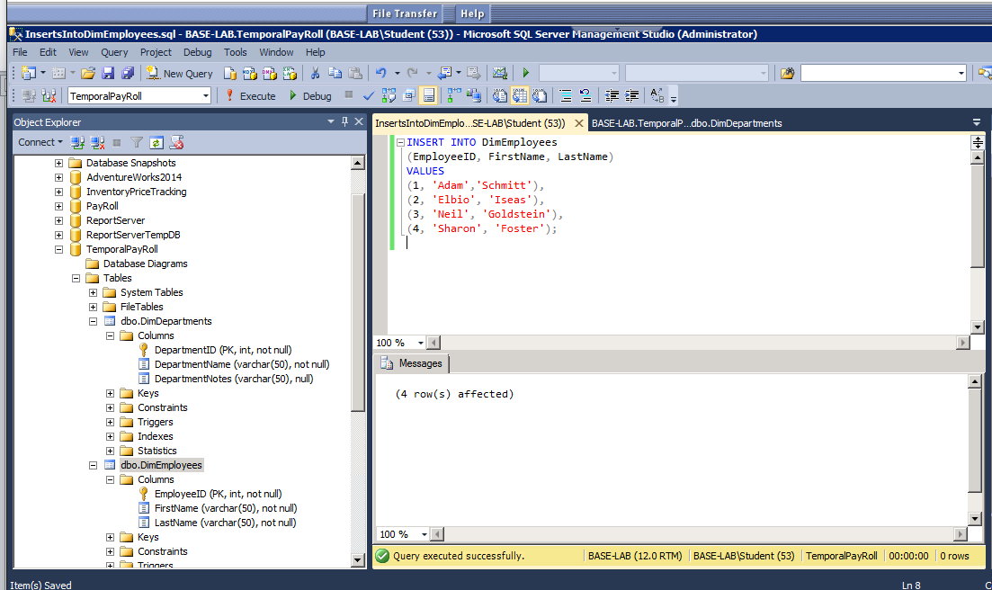
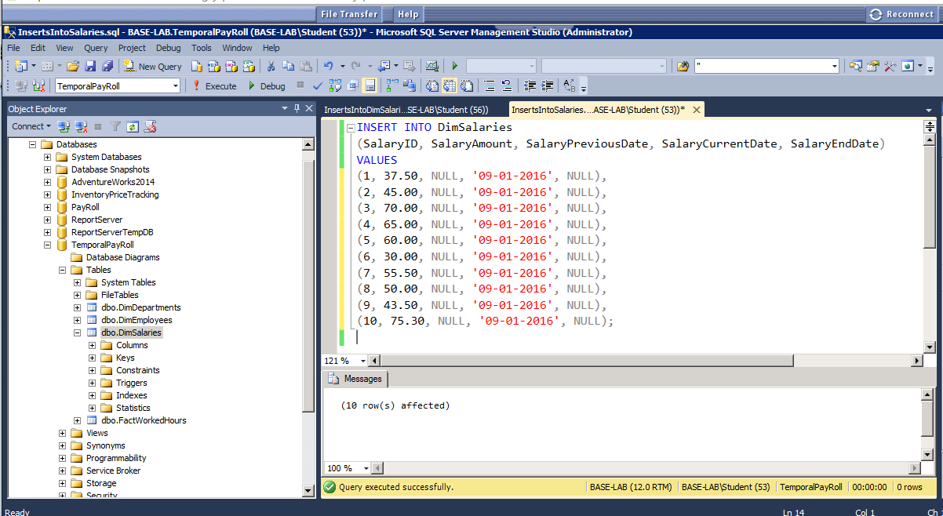
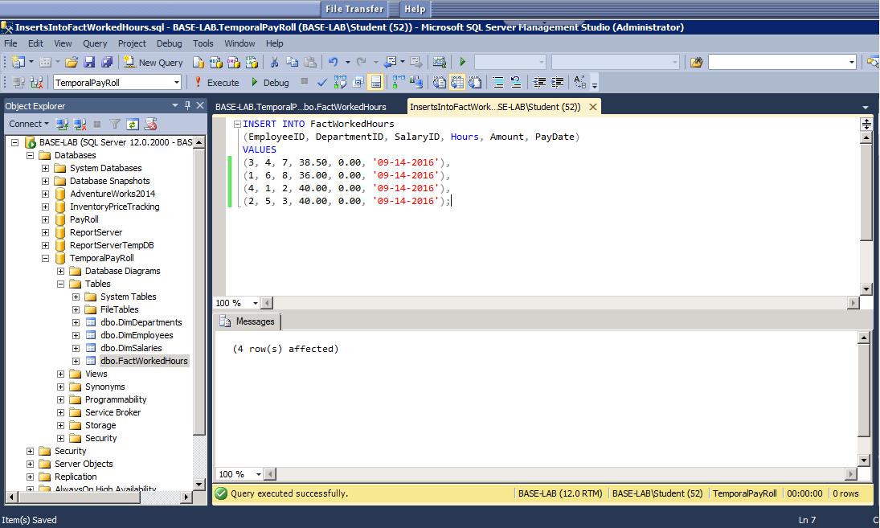
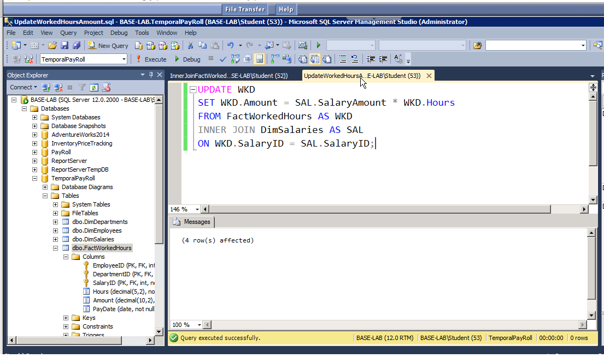
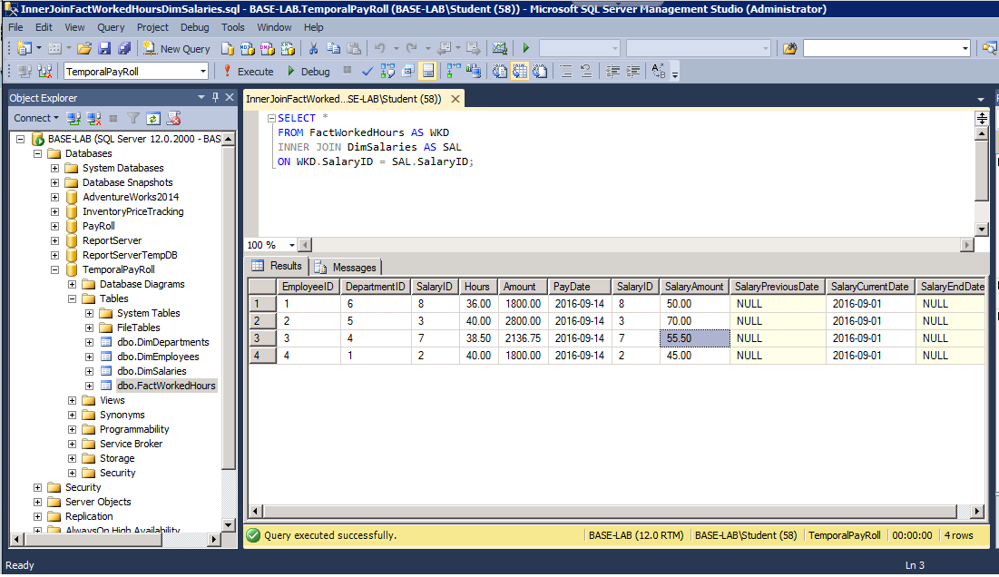
SQL SERVER SCRIPTS
RESULTS

Slide 5
E-mail to company’s cio
From: elbio.iseas@hotmail.com
To: DevinDickens@ITConsulting.com
CC:
Subject: TemporalPayRoll Database Normalization Process Explanation
Hi Devin,
This is Elbio Iseas from the IT Department and I will explain in this email the normalization process of the TemporalPayRoll database. The TemporalPayRoll database is part of the Online Transaction Processing (OLTP). As any database the normalization process ensures that there is no data redundancy in the database. Between some of the benefits of normalization are:
faster access to the information,
saving in storage space, and
it makes an easier database administration.
The normalization process consists of several forms or stages of the database. This email will address the first three normal forms:
The 1st normal form
In this stage the table cannot have repeated groups or columns.
Columns will have only one value.
Each row will be unique.
All attributes will depend on the primary key (the column value or group of columns that build the primary key which uniquely identify the row).
The 2nd normal form
The table needs to be in the 1st normal form.
There is no partial key dependency. This means that there will be no prime key attached to a non prime key of a compound key.
The 3rd normal form
No transitive dependency will be allowed. This means that if there is transitive dependency in the row it has to be broken in as many relations as it requires.
If you have any questions, please reply to this e-mail. Thank you.

Slide 6
THE NORMALIZATION PROCESS
The normalization process consists of the first three normal forms:
1st normal form
There are no repeated group.
Only one value per column, not several values.
Each row is unique.
Attributes depend on the primary key.
2nd normal form
It must be in 1st normal form.
There is no partial key dependency.
3rd normal form
No transitive dependency allowed.

Slide 7
cONCLUSION
The TemporalPayRoll Database helps the process of transactions online with the OLTP system. The normalized database ensures the quick access to the information as well as the Dimensional Model of the database.

